Slide 1
Role and Responsibilities of CSD in China's Investor Protection Scheme
SHEN Bing
Panel Discussion at 16th Annual Meeting of ACG
Bali, September 20, 2012

Slide 2
Contents
Call for More Responsibility
China's Stock Market Structure and Investor Protection Framework
CSD’s Role and Responsibilities- Our Practice
Development Initiatives to Foster Better Protection

Slide 3
Call for More Responsibility
CSDs are very important financial market infrastructures that support investor protection via asset protection and services, thus strengthen investor confidence
Debate and discussions about investor protection issues since the financial melt-down 2008
CPSS/IOSCO New Standards (PFMI) advocate reform of CSD account structure in order to achieve greater investor transparency and protections

Slide 4

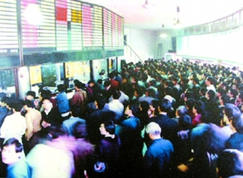
China‘s Stock Market Structure and Investor Protection Framework
A Market Dominated by Retail Investors
90 million individual investors, ~13% of urban residents
Contribute 80% of trading volume
Hold 50% of ‘liquid’ market value
130 million active securities accounts, with 10~15million new accounts opened in each one year
4

Slide 5
China‘s Market Structure and Investor Protection Framework
Organizations | Main Responsibilities | Laws & Regulations
Investor Protection Bureau, China Securities Regulatory Commission (CSRC) | Regulation and policy making; Establishing and improving investor protection and remedy scheme; Supervising and coordinating SROs and intermediaries activities in this regard, and etc. | Law of People’s Republic of China on Securities(2005), Rules on Supervision and Risk Disposal of Securities Companies (2008)
China Securities Investor Protection Fund Co. Ltd (SIPF) | Raising and managing the SIPF fund; Monitoring financial risks of securities firms; Participating in resolution process of insolvent firms, and etc. | Administration Measures for Securities Investor Protection Fund (2005)
Shanghai & Shenzhen Stock Exchanges | Supervising and implementing information disclosure of public companies; Investor education and risk alert for products and companies, and etc. | Administrative Measures for Stock Exchanges (2001)
China Securities Depository & Clearing Co. Ltd (SD&C) | Asset protection and servicing; Mitigation of systemic risks concerning the CSD; Investor education and service etc. | Administration Measures for Securities Registration, Clearing and Settlement (2006)

Slide 6
CSD‘s role and responsibilities – our Practice
Asset Protection
  Legal basis
    Direct holding market
    Segregated account structure at the level of CSD
    Real-name account discipline
  Operational advantages
    Fully dematerialized
    Strong Book entry system and communications networks
CSD’s Book
Broker A
Investor A
100 shares
Investor B
200 shares
Broker B
Investor C
200 shares
Register
of the share-holders
Broker A’s Book
Investor A
100 shares
Investor B
200 shares
Broker B’s Book
Investor C
200 shares

Slide 7
CSD‘s role and responsibilities – our Practice
    Asset Services
  On-line voting facilities
  Automation of Corporate action entitlement
  Tax withholding service
System Disruption Mitigation
  Operational Risk management
  Credit and Liquidity
  Risk Mgt
Issuer
Corporate Actions
Voting
Book-entry
& Register
CSD
Stock dividend
voting
Cash dividend
Internet access
www.chinaclear.cn
Brokers
Cash Dividend
Client’s Cash Account

Slide 8
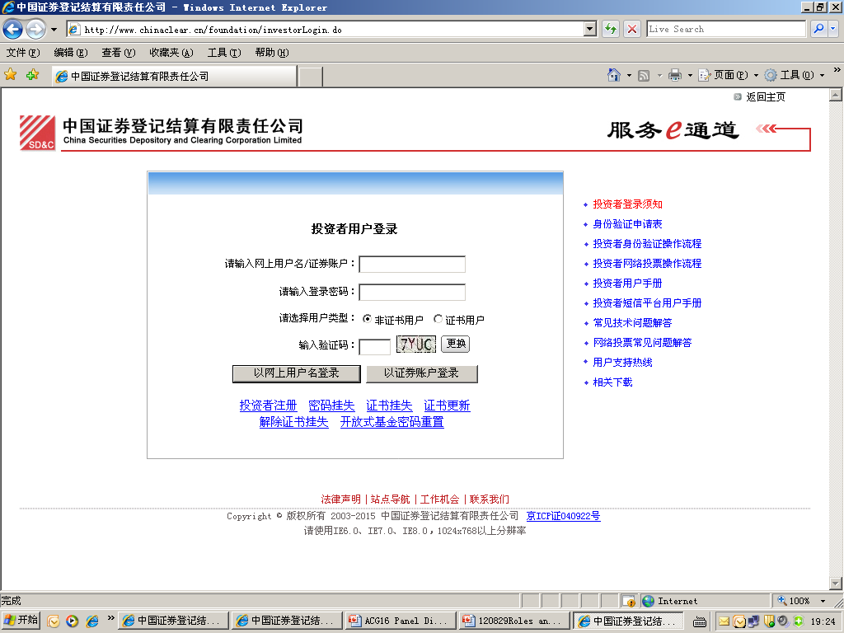
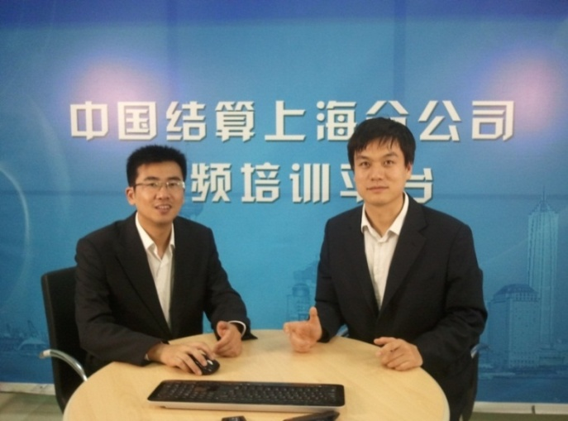
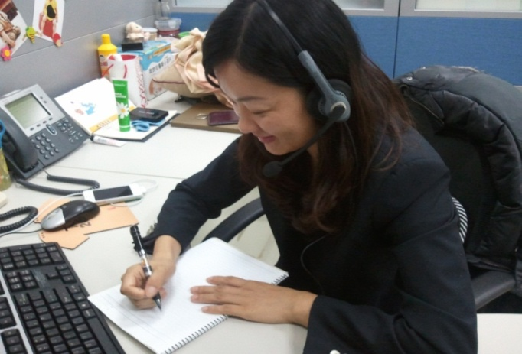
CSD‘s role and responsibilities – our Practice
Investor Service and Education
  Counter service
  On-line inquiry service
  Call center service
  On-line investor consultation and training events
  Educational Publications

Slide 9
CSD‘s role and responsibilities – our Practice
Date | Major Improvement on Investor Protection and Service
2004.11 | Provide investors enquiry service of account holdings and transactions records
2004.12 | Initiate online proxy voting of shareholders’ meeting.
2005.01 | The completion of clearing route switch ensure the implementation of clients’ third party cash custodian.
2007.02 | Implement investors’ self-service query terminal system
2007.10 | Implement dormant securities accounts segregation and begin the reactivation procedure
2010.12 | Customer service hotline, 4008-058-058, went live officially
2012.05 | Complete the first securities company proxy pledge registration business.
2012.05 | Provide the SMS service to all listed companies if the amount of securities which were pledged or judicially frozen is greater than 5% of their total share capital

Slide 10

CSD‘s role and responsibilities – our Practice
Establish knowledge base
Unify solution standard
Enhance voice query self-service
Call service Analysis
Service Skills training
Service monitoring

Slide 11


Development Initiatives to Foster Better Protection
Market Reforms and Development
  Development of multi-tier capital market
  Products and trading innovations,
  and increasingly
  Growth of cross border transactions

Slide 12
Development Initiatives to Foster Better Protection
  Asset Protection
  Hybrid account structure without sacrificing transparency
      Single identification and account access for investors to all depository securities
  Portability of customer assets among different brokers

Slide 13
Development Initiatives to Foster Better Protection
  Asset Services
  Move from transaction-oriented services to customer-centered services
  Introduce new and flexible asset services for issuers and investors, including employee share ownership program, collateral management, and etc.
  Explore asset services for cross-boarder transactions

Slide 14
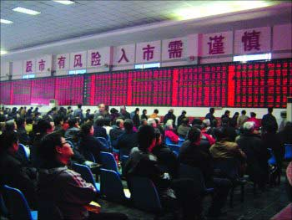
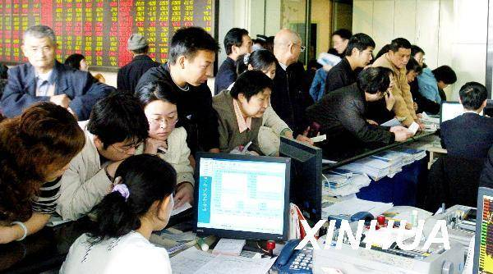
Development Initiatives to Foster Better Protection
  Investor Service and Education
  Connect with investor via new technologies
  Continuous improvement of services and call center
  Commercial application of data warehouse
  Overhaul of company website

Slide 15
Thank you
bshen@chinaclear.com.cn

